Slide 1
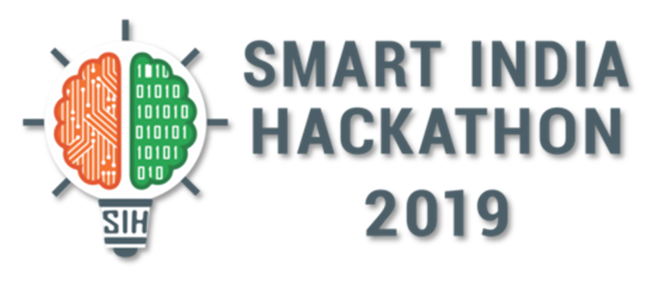
PROBLEM STATEMENT: LB5(MINDTREE): MECHANISM TO SAVE MEDICINE FROM GETTING WASTED
SAVE MEDICINES SAVE LIFE

Slide 2
INTERPRETATION
We studied about the problem statement and found that a number of medicines are getting wasted everyday.
India is likely to generate about 775.5 tons of medical waste per day by 2022 from the current level of 550.9 tons per day growing at Compound Annual Growth Rate (CAGR) .
According to 2002 Agency for Healthcare Research and Quality report, about 7,000 people were estimated to die each year from medication errors.
As the number of medicines get wasted ,pollution level increases simultaneously which degrade our environment as well as our lifestyle.
So , there is a crucial need to find a sustainable solution for this problem.

Slide 3
PROJECT OVERVIEW
We will deploy web app which takes unutilized medicines from the people and vend it to the needy ones.
The user can donate the unused medicines for the ones who can’t afford.
The opened/used syrups are not accepted.
We will have multiple pharmaceutical shops in each city(locality) who keeps the stock of medicines donated by people.
In our app , the donor first have to fill the credentials of the medicine he/she wishes to donate. Through live tracking we will allot the nearest center to donate the medicine.
The people who wishes to connect with us as an agent for collecting medicine can join us for free. If the donor finds difficulty in reaching the center, the agent will take medicine from donor’s place and submit to the center.
Recipient can easily get the medicines from the nearest center. Their is no such delivery option for them.
We are also accepting expired medicines/medicine whose expiry date is unknown so, that they can be disposed properly by Pharmaceutical Company for avoiding environmental pollution.
User can also give their feedbacks based on service of the app..

Slide 4
PURPOSE OF PROJECT
Acc. to the statistics ,India’s population is increasing by 26 million annually and everyday many people suffer because of not getting the proper treatment. There is a crucial need to utilize the resources and thus , this app recycle and reuse unused medicines.
The purpose of the project is promote the medical reusability through the collective help of the society.
It promotes the integrity of our system enhancing the well being of the society.
The donation of the medicines is appreciated as it will be a big help to those people who can’t buy the medicines due to low income.
The app will help in saving more and more life by providing each and every person with the right medicine.

Slide 5

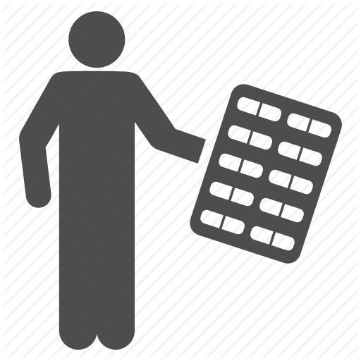


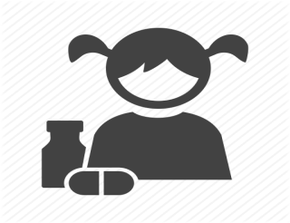



PROTOTYPE MODEL
Donate medicines
Take expired medicines for disposal and evaluation
SELLER
MEDICAL CENTER
DONOR
Submit medicines
Collect
medicines
PHARMACEUTICAL COMPANY
LOGIN/REGISTER
takes medicines
AGENT/HELPER
LOGIN/REGISTER
RECEIPIENT
Register details of unused
Medicines , get known
To nearest center
Know nearest center
WEB APP
View and select medicines , contact to doctor
LOGIN/REGISTER
data
Monitor all activities
ADMIN
DATABASE

Slide 6
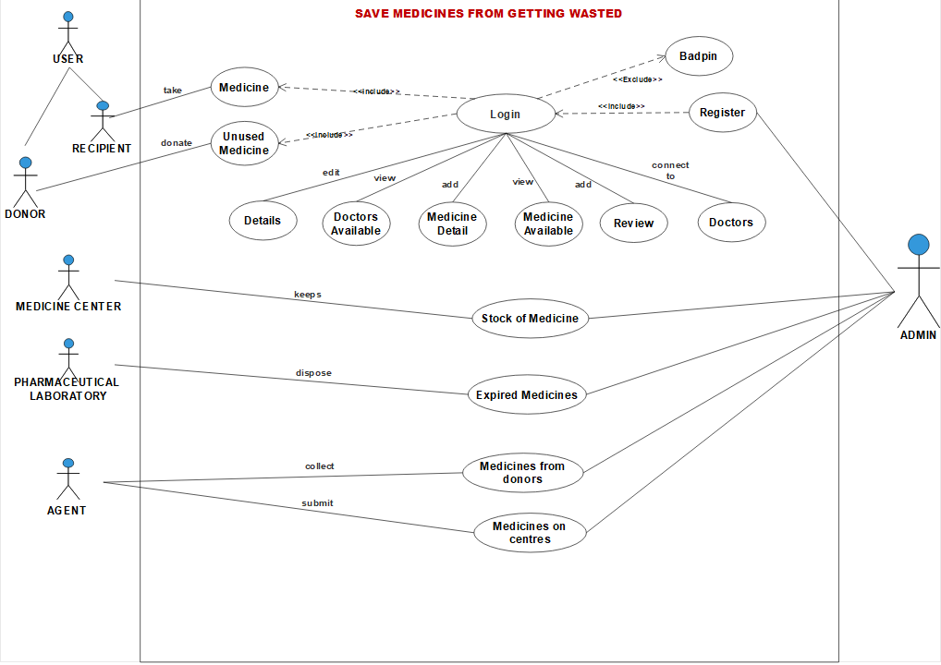
USE CASE

Slide 7



TECHNOLOGY STACK
Django is a python based free and open source web framework which follows MVC(Model – View - Controller) architectural pattern.
PostgreSQL is an open source object-relational database management system . It can handle workloads ranging from single-machine applications to large internet-facing applications with many concurrent users.
Bootstrap is an open source toolkit for developing with HTML , CSS , and JS . It build responsive mobile projects on web with the world’s most popular front-end component library.

Slide 8
IMPLEMENTATION
USER : There are two types of users which can connect to our web-application. These are :
DONOR : The donors are the users who donates the unutilised medicines stored in their homes from the web-application .For donating medicines they first need to register themselves on the app. Then they provide the minimal details of the medicines they want to donate. Donation of illegal drugs is not entertained and if found, severe actions will be taken.
RECIPIENT : The recipient are the users or patients who takes the need medicine. The recipient can get these medicines for free if he/she is below poverty line. For receiving medicines they first need to register themselves on the app. For high dosed medicines (prescription drugs), the recipient have to attach the prescription of the doctor.

Slide 9
There are many other users of this web-application which completes this chain of medicines from the donor to the recipient. These users are :
MEDICINE STOCK CENTRES : Medicine Stock Centres are the hospitals and pharmaceutical shops that keeps the stock of medicines donated by the people.
AGENTS : Agents are those people who help our website by collecting medicines from those donors who want to donate medicines but unable to come to the centres for submitting them. People who are interested in doing social service can work as an agent for the app.
PHARMACEUTICAL COMPANIES : A Pharmaceutical company is a commercial business licensed to research, develop and/or distribute medicines, most commonly in the context of healthcare. All the expired medicines are sent to these companies for the safe disposal so that the environmental pollution can be avoided.

Slide 10
CONCLUSION FROM SURVEY
We had conducted a survey in our locality before this hackathon and we found many things related to our problem statement. Here is the survey report as follows:
Pharmacy
Pharmacies accept many unused medicines from the customers, only when they provide the bill. The medicines which get expired and are in the range of up to 6 months are sent back to the companies and if expiration date crosses 6 months then they are sent to the labs for the disposal process.
Society
In the society survey we found that every person keeps medicines at their home. Almost 90% of People are willing to donate their unused medicines but the issue is that they have very much busy schedule that even they don’t know how many medicine is of their use and how many are waste.

Slide 11
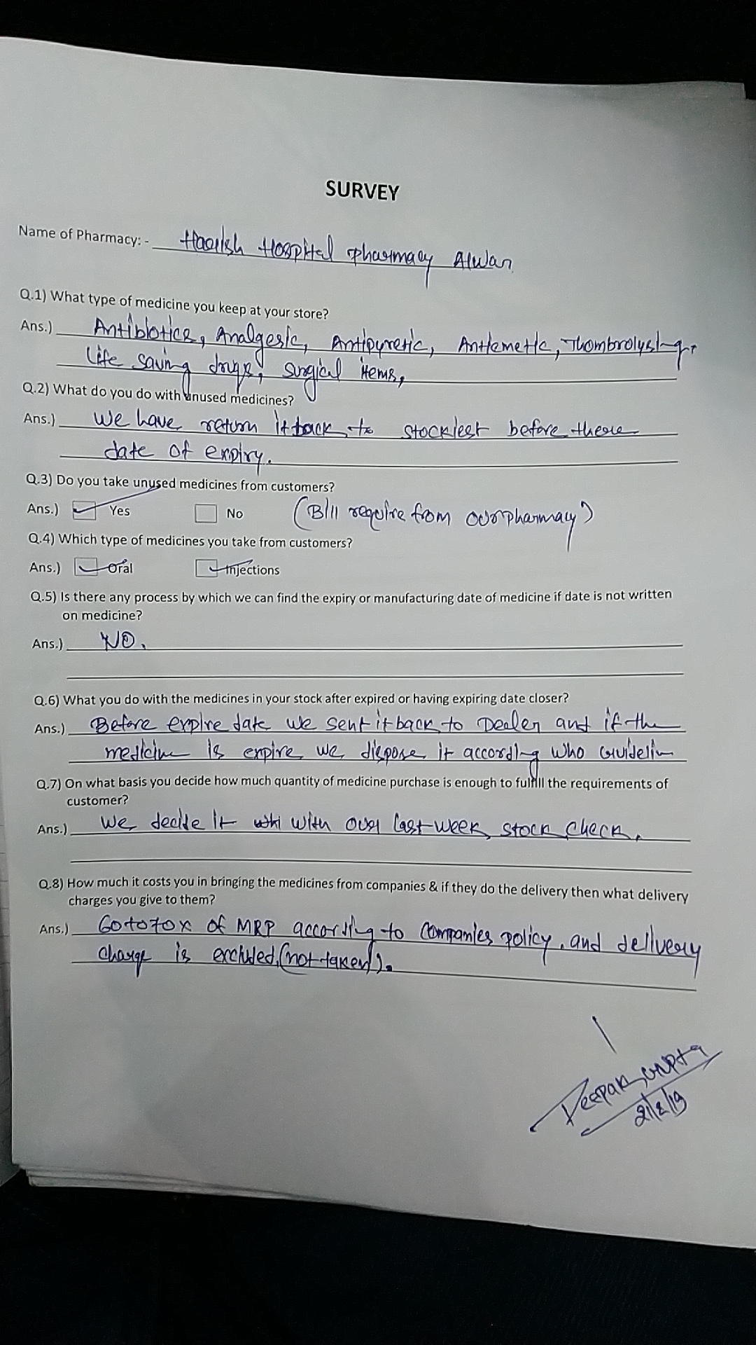
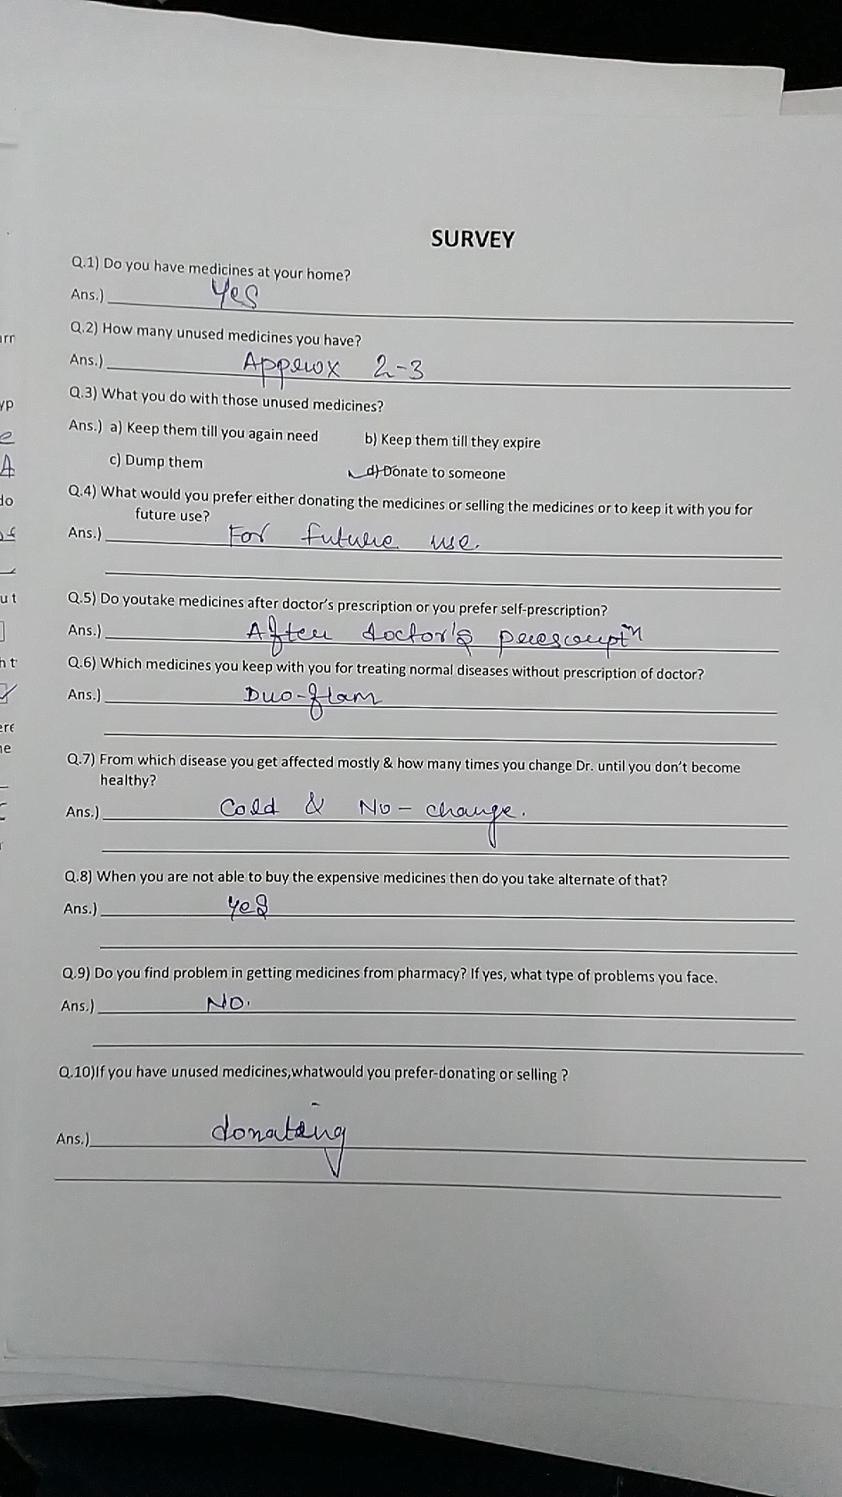
SURVEY PAPERS
Pharmacy
locality

Slide 12
CONCLUSION
The project is identified by the merits of the system offered to the user. The merits of this project are as follows :
It is a responsive web app , i.e. it can run on any size gadget like laptop , tablet , mobile phone etc.
This web-application bridges the information gap between the medicines and the needy people.
This web-application provides a simple platform that connects the unused medicines lying at the homes to the people who really need this but can’t afford to buy.
User is provided with the option of forget password as if he forgets his password he can change it by entering the email address.
Very easy to use , i.e. user friendly .

